Slide 1
Quiz on Lecture 6
Please receive the quiz handout from Cyrille, Oliver, Vincent, Jan
Complete the quiz in silence
Hand the quiz back

Slide 2
Quiz on Lecture 6
What is one reason why companies store more and more data?
  To comply with regulations that require them to historise their data for auditing purposes
  To reduce the need for advanced computing resources.
  Because data is an asset that has the potential to drive a competitive edge
  Because the cost of electricity has come down
What is the successor of Map Reduce for distributed computing?
  MinIO
  Apache Hadoop
  Apache Spark
  Scala
  Vertex AI
What type of storage has the coldest "temperature" (in terms of data access frequency)?
  HDD
  SSD
  RAM
  magnetic-tape
Which of these is true about using cloud infrastructure services
  When using PaaS, you must provision both application and its middleware but not the Operating system.
  When using PasS, you must provision both the application and its runtime but not the Operating system.
  When using IaaS, you must provision both the application and its operating system but not the Virtualization.
  When using IaaS, you need to provision both Operating system and its virtualization, but not Servers.
What problem in the two-tier "modern Data Warehouse" does the Lakehouse solve?
  Complexity & cost
  The lack of support for SQL queries.
  The inability to connect to front-end visualization tools.
  The high cost of cloud-based data storage.
A startup uses Google Cloud Run to deploy a data-serving API, stores datasets in AWS S3, and manages virtual machines on Azure. Which of the following correctly classifies the layers they are using
  Cloud Run (SaaS), S3 (PaaS), Azure VMs (IaaS)
  Cloud Run (PaaS), S3 (IaaS), Azure VMs (SaaS)
  Cloud Run (PaaS), S3 (IaaS), Azure VMs (IaaS)
  Cloud Run (IaaS), S3 (PaaS), Azure VMs (SaaS)

Slide 3
Quiz on Lecture 6 (Answers)
What is one reason why companies store more and more data?
  To comply with regulations that require them to historise their data for auditing purposes
  To reduce the need for advanced computing resources.
  Because data is an asset that has the potential to drive a competitive edge
  Because the cost of electricity has come down
What is the successor of Map Reduce for distributed computing?
  MinIO
  Apache Hadoop
  Apache Spark
  Scala
  Vertex AI
What type of storage has the coldest "temperature" (in terms of data access frequency)?
  HDD
  SSD
  RAM
  magnetic-tape
Which of these is true about using cloud infrastructure services
  When using PaaS, you must provision both application and its middleware but not the Operating system.
  When using PasS, you must provision both the application and its runtime but not the Operating system.
  When using IaaS, you must provision both the application and its operating system but not the Virtualization.
  When using IaaS, you need to provision both Operating system and its virtualization, but not Servers.
What problem in the two-tier "modern Data Warehouse" does the Lakehouse solve?
  Complexity & cost
  The lack of support for SQL queries.
  The inability to connect to front-end visualization tools.
  The high cost of cloud-based data storage.
A startup uses Google Cloud Run to deploy a data-serving API, stores datasets in AWS S3, and manages virtual machines on Azure. Which of the following correctly classifies the layers they are using
  Cloud Run (SaaS), S3 (PaaS), Azure VMs (IaaS)
  Cloud Run (PaaS), S3 (IaaS), Azure VMs (SaaS)
  Cloud Run (PaaS), S3 (IaaS), Azure VMs (IaaS)
  Cloud Run (IaaS), S3 (PaaS), Azure VMs (SaaS)

Slide 4
Designing and Deploying
end-to-end
Production Grade ML Applications
Lecture 7: Data Engineering — The DE Lifecycle in Depth
October 2025
Oliver Angélil & Vincent Frimpong

Slide 5
Contents of three Data Engineering Lectures:
Lecture 6: Foundation and Building Blocks
  What is Data Engineering (DE)?
  The DE lifecycle
  Types of Data Architectures
  On-Prem vs Cloud (IaaS vs PaaS vs SaaS)
  Infrastructure as Code (IaC)
Lecture 7: The DE Lifecycle in Depth
  Source Systems & Storage
  Ingestion
  Modeling, and Transformation
  Serving Data for Analytics, Machine Learning, and Reverse ETL
Lecture 8: Learning by Doing — Building your own DE Pipeline with Dagster
this lecture
Oliver

Slide 6
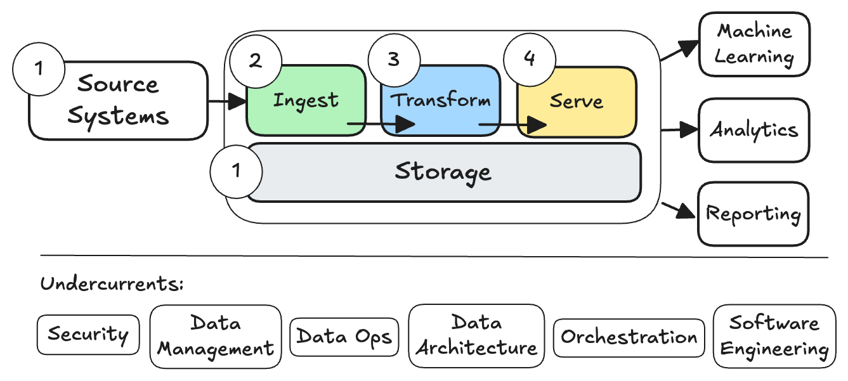
2.1 Source Systems & Storage
Oliver

Slide 7
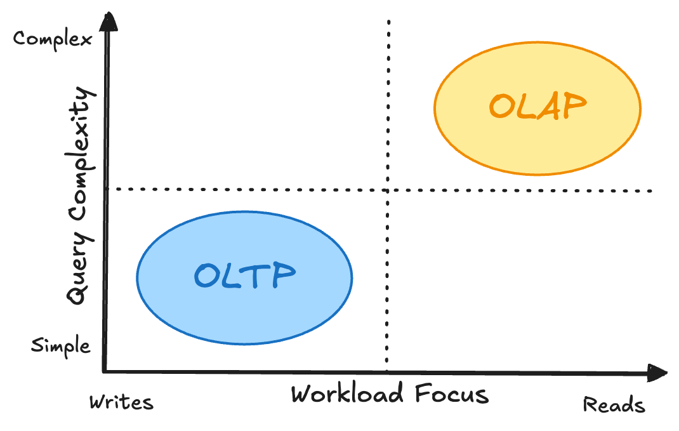
2.1 Source Systems & Storage: OLTP vs OLAP Databases
Online Transaction Processing (OLTP) vs Online Analytical Processing (OLAP)
Oliver

Slide 8
2.1 Source Systems & Storage: OLTP vs OLAP Databases
 | OLTP Database | OLAP Database
Processing Type | transactional | analytical
Query Complexity | simple | complex
Operation Types | quick CRUD (Create, Read, Update, Delete) transactions | large read scans across many rows
Storage Type on Disk | row | column
Usage Pattern | repetitive | ad hoc
Design | normalized (3NF) | denormalized
Example Query | INSERT INTO Orders (OrderID, CustomerID, OrderDate, TotalAmount, Status) VALUES (1001, 54321, GETDATE(), 99.99,'Pending') | select 10 years of data, groupby year, and calculate the sum of sales per year
Example DBs | MySQL, PostgreSQL | Google BigQuery, Snowflake, DuckDB
Oliver

Slide 9
2.1 Source Systems & Storage: OLTP vs OLAP Databases
 | OLTP Database | OLAP Database
Processing Type | transactional | analytical
Query Complexity | simple | complex
Operation Types | quick CRUD (Create, Read, Update, Delete) transactions | large read scans across many rows
Storage Type on Disk | row | column
Usage Pattern | repetitive | ad hoc
Design | normalized (3NF) | denormalized
Example Query | INSERT INTO Orders (OrderID, CustomerID, OrderDate, TotalAmount, Status) VALUES (1001, 54321, GETDATE(), 99.99,'Pending') | select 10 years of data, groupby year, and calculate the sum of sales per year
Example DBs | MySQL, PostgreSQL | Google BigQuery, Snowflake, DuckDB
Oliver

Slide 10
2.1 Source Systems & Storage: OLTP vs OLAP Databases
Storage Type: Column vs Row
SELECT SUM(COL_A) FROM mytable WHERE COL_C IN (2,3,4);
Row Partitioned Table (OLTP DBs):
Col_A | Col_B | Col_C | Col_D | Col_E | Col_F
1 | 1 | 1 | 1 | 1 | 1
2 | 2 | 2 | 2 | 2 | 2
3 | 3 | 3 | 3 | 3 | 3
4 | 4 | 4 | 4 | 4 | 4
5 | 5 | 5 | 5 | 5 | 5
Three rows & all columns must be read to answer the query
Advantages of row storage:
Fast inserts, updates, deletes (good for OLTP)
Good for queries that need the whole row
Disadvantages of row storage::
Slow data aggregation
Poor compression, since rows have different data types and values
Oliver

Slide 11
2.1 Source Systems & Storage: OLTP vs OLAP Databases
Storage Type: Column vs Row
SELECT SUM(COL_A) FROM mytable WHERE COL_C IN (2,3,4);
Column Partitioned Table (OLAP DBs):
Col_A | Col_B | Col_C | Col_D | Col_E | Col_F
1 | 1 | 1 | 1 | 1 | 1
2 | 2 | 2 | 2 | 2 | 2
3 | 3 | 3 | 3 | 3 | 3
4 | 4 | 4 | 4 | 4 | 4
5 | 5 | 5 | 5 | 5 | 5
Advantages of column storage::
Fast data aggregation, since aggregates are usually performed on a subset of columns across many rows
High compression, since columns have uniform data types & often recurring values
Disadvantages of column storage:
Slow single row modifications
Two columns & all rows must be read to answer the query
Oliver

Slide 12
2.1 Source Systems & Storage: OLTP vs OLAP Databases
Storage Type: Column vs Row
SELECT SUM(COL_A) FROM mytable WHERE COL_C IN (2,3,4);
Not Partitioned Table:
Col_A | Col_B | Col_C | Col_D | Col_E | Col_F
1 | 1 | 1 | 1 | 1 | 1
2 | 2 | 2 | 2 | 2 | 2
3 | 3 | 3 | 3 | 3 | 3
4 | 4 | 4 | 4 | 4 | 4
5 | 5 | 5 | 5 | 5 | 5
All rows & columns must be read to answer the query
Source: URL
Oliver

Slide 13
2.1 Source Systems & Storage: OLTP vs OLAP Databases
More examples of queries and how they perform on OLTP vs OLAP DBs
Query | Faster on Row or Column Storage? | Reason
SELECT Col_A FROM table WHERE Col_B = 2; | Similar | - Only 1 cell is being selected, so neither many rows or columns need to be read
SELECT * FROM table WHERE Col_A = 1; | Row (OLTP) | - Row DB: all columns instantly available when correct row is found! - Column DB: every column must be read to return all column values
SELECT sum(Col_D)FROM table; | Column (OLAP) | - Row DB: every row must be read with all (unneeded) columns - Column DB: only Col_D is read
Oliver

Slide 14
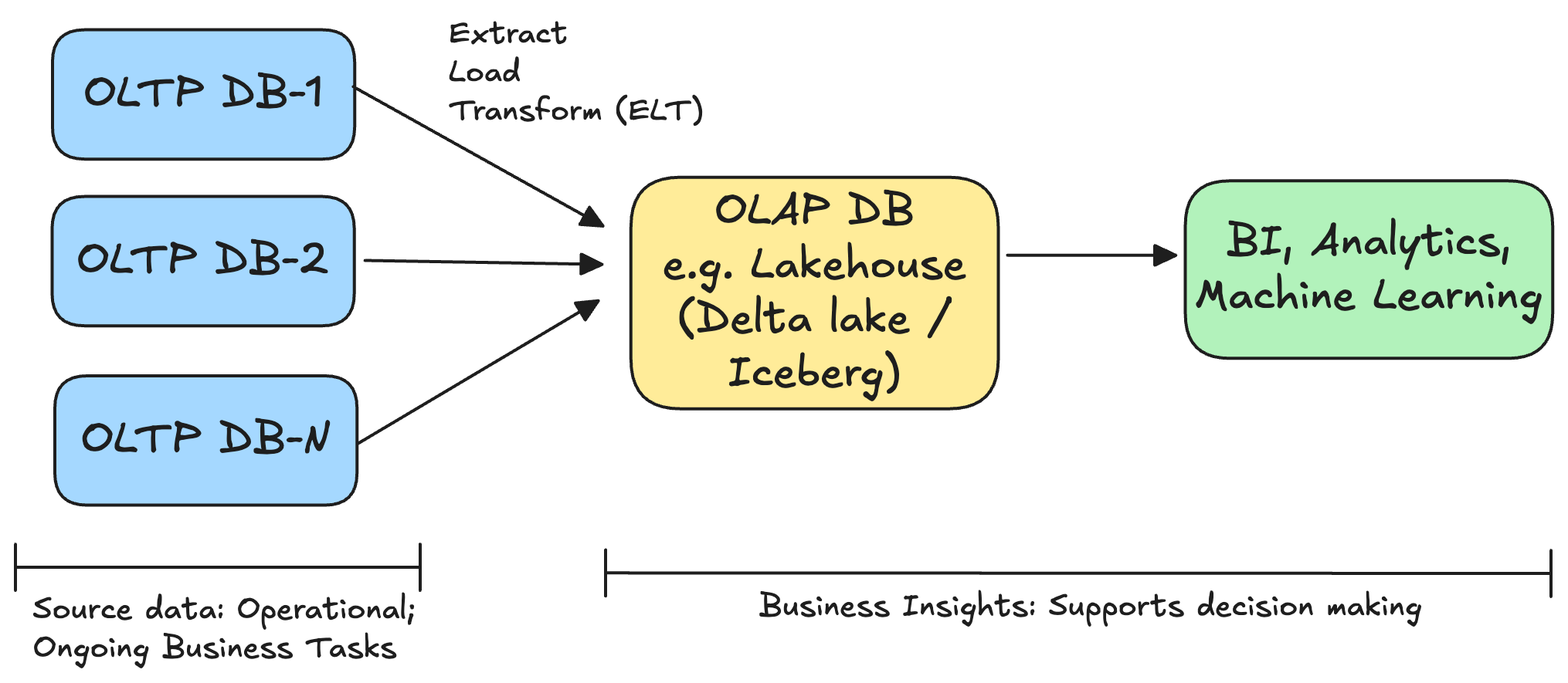
2.1 Source Systems & Storage: OLTP vs OLAP Databases
Recommended modern (2025) setup:
Oliver

Slide 15
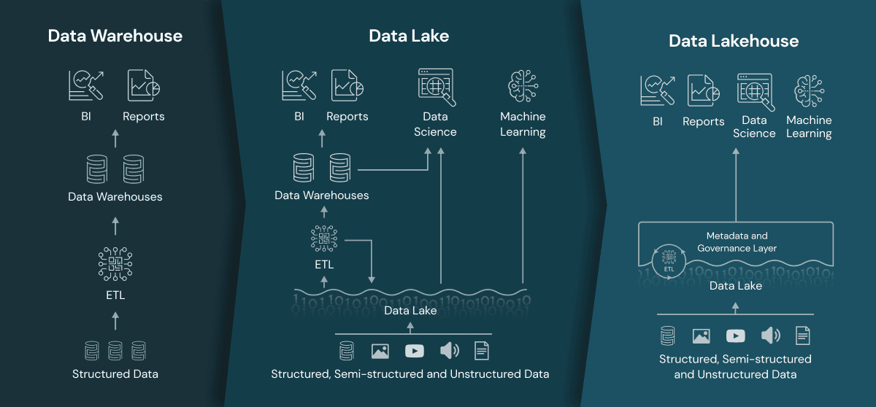
2.1 Source Systems & Storage: The rise of the Lakehouse
1980s
2010s
2020s
problems:
- high cost (coupled storage & compute)
- only structured data
problems:
- complex & high cost to keep 2 repos consistent
- data lake has no versioning, indexing, ACID transactions
- DWH suited for small data queries (row storage)
Oliver

Slide 16
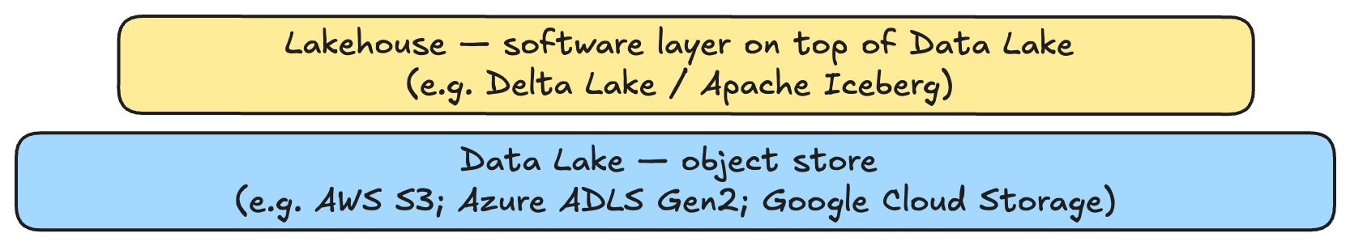
2.1 Source Systems & Storage: The rise of the Lakehouse
What is a Data Lake?
  can store any type of data (similar to the hard disk on a laptop): structured & unstructured
  flat structure: no folder hierarchy. Rather a GUID for each file stored
  object "blob" storage:
    an "object" is any file: txt; csv; json; images; video; audio.
    immutable: once written, objects cannot be edited. If changes are need, rewrite entire object
    highly scalable & performant: storage is cheap nowadays — simply add more devices to the pool to scale
  schema-on-read: Schema is applied only when reading — allows for any data type to be stored in raw format without predefined schema.
What is a Lakehouse?
  A portmanteau of the words "Data Warehouse" & "Data Lake" -> combines the best of both
  a software layer on top of a Data Lake, adding adding features like ACID transactions typically found in Data Warehouses; schema evolution; data versioning; & improved performance.
Oliver

Slide 17
2.1 Source Systems & Storage: The rise of the Lakehouse
Benefits of a Lakehouse:
  Simplicity: one repo for any type of data
  ACID transactions: is a set of properties of database transactions intended to guarantee data validity despite errors, power failures, and other mishaps (more detail not required for this course)
  Schema Enforcement: allow you to define a schema for your data and reject writes that don't conform, improving data quality.
  Schema Evolution: support changing the schema over time (e.g., adding new columns, renaming columns) without requiring a full rewrite of the historical data
  Data Versioning: Roll back to any historical version of the data as it existed at a specific point in time.
All major cloud providers offer a lakehouse solution:
  Azure OneLake (ADLS Gen2 + Delta Lake)
  GCP BigLake (Google Cloud Storage + Apache Iceberg)
  AWS Lake Formation (S3 + Apache Iceberg)
Oliver

Slide 18
2.2 Ingestion
Vincent

Slide 19
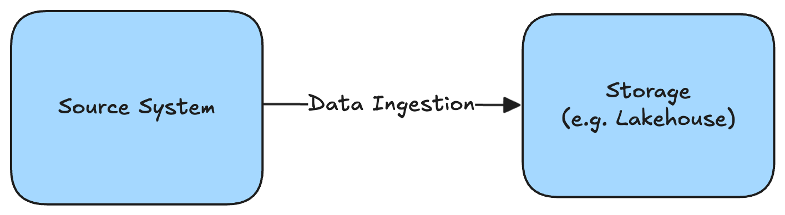
2.2 Ingestion: Definition
What is Data Ingestion? "Data ingestion implies data movement from source systems into storage in the data engineering lifecycle"
Two ingestion paradigms:
Batch:
  All data are often re-processed, usually at longer time intervals than streaming (e.g. weekly; monthly). Data are not a continuous stream of data like time series data
Streaming:
  Only new data are processed in an incremental ("append-only") fashion, usually at shorter time intervals (e.g. hourly; every minute; every second)
Vincent

Slide 20
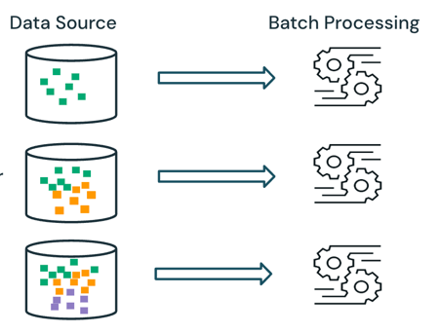
2.2 Ingestion: Streaming vs Batch
Batch processing:
Examples:
Payroll processing (monthly)
Image/Video Processing
Report generation (e.g. sales)
Day 1
Day 2
Day 3
Vincent

Slide 21
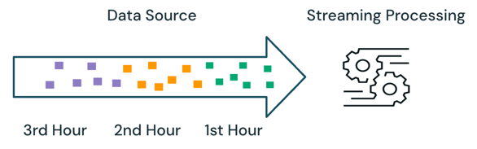
2.2 Ingestion: Streaming vs Batch
Streaming:
Minute 1
Minute 2
Minute 3
Examples:
Stock market trading
IoT processing (data from sensors, e.g. temperature; pressure on machinery or wearable devices)
Network monitoring & anomaly detection: continuously monitor network traffic to identify unusual patterns / security breaches
Vincent

Slide 22
2.2 Ingestion: Streaming vs Batch
Streaming example with IoT data — newly appended rows in blue; watermark ("checkpoint") in red:
Example of incremental "append-only" table:
query & ingest
TimeStamp | Key | Value | Unit
2025-07-23T07:32:24Z | SensorA | 285.21 | K
2025-07-23T07:32:38Z | SensorB | 3.1 | Bar
Minute 1
(query between 2025-07-23T07:31:45Z & 2025-07-23T07:32:45Z)
query & ingest
TimeStamp | Key | Value | Unit
2025-07-23T07:32:24Z | SensorA | 285.21 | K
2025-07-23T07:32:38Z | SensorB | 3.1 | Bar
2025-07-23T07:33:11Z | Sensor A | 287.59 | K
2025-07-23T07:33:44Z | Sensor B | 3.3 | Bar
source system
Minute 2
(query between 2025-07-23T07:32:45Z & 2025-07-23T07:33:45Z)
TimeStamp | Key | Value | Unit
2025-07-23T07:32:24Z | SensorA | 285.21 | K
2025-07-23T07:32:38Z | SensorB | 3.1 | Bar
2025-07-23T07:33:11Z | Sensor A | 287.59 | K
2025-07-23T07:33:44Z | Sensor B | 3.3 | Bar
2025-07-23T07:34:14Z | Sensor A | 279.5 | K
2025-07-23T07:34:16Z | Sensor B | 3.2 | Bar
query & ingest
Minute 3
(query between 2025-07-23T07:32:45Z & 2025-07-23T07:33:45Z)
Bonus: Q: what is "Z" in the timestamp? 😉
Vincent

Slide 23
2.3 Modeling and Transformation: normalised vs denormalized
 | OLTP Database | OLAP Database
Processing Type | transactional | analytical
Query Complexity | simple | complex
Operation Types | quick CRUD (Create, Read, Update, Delete) transactions | large read scans across many rows
Storage Type on Disk | row | column
Usage Pattern | repetitive | ad hoc
Design | normalized (3NF) | denormalized
Example Query | INSERT INTO Orders (OrderID, CustomerID, OrderDate, TotalAmount, Status) VALUES (1001, 54321, GETDATE(), 99.99,'Pending') | select 10 years of data, groupby year, and calculate the sum of sales per year
Example DBs | MySQL, PostgreSQL | Google BigQuery, Snowflake, DuckDB
Vincent

Slide 24
2.3 Modeling and Transformation: normalised vs denormalized
3NF is defined as a table where the 1NF, 2NF, & 3NF are all met.
the 1NF is abided by when:
  the table has a Primary Key (PK)
  each cell contains a single value, not a list of values
Total data cells in model: 6 * 5 = 30
EmployeeID (PK) | ProjectID (PK) | EmployeeName | HoursWorked | ManagerID | ManagerName
101 | P01 | Alice | 25 | M5 | David
101 | P02 | Alice | 30 | M5 | David
102 | P01 | Bob | 40 | M6 | Evelyn
103 | P02 | Carol | 15 | M5 | David
103 | P03 | Carol | 20 | M5 | David
1NF ✅
2NF ❌Why? Because EmployeeName, ManagerID, and ManagerName only depend on EmployeeID
3NF ❌
Vincent

Slide 25
2.3 Modeling and Transformation: normalised vs denormalized
2NF is defined as a table where:
  the 1NF is abided by
  the 2NF is abided by: has no partial-dependencies (i.e. a non-key attribute depends on only a part of the composite PK)
Total data cells in model: 3 * 5 + 4 * 3 = 27
EmployeeID (PK) | ProjectID (PK) | HoursWorked
101 | P01 | 25
101 | P02 | 30
102 | P01 | 40
103 | P02 | 15
103 | P03 | 20
EmployeeID (PK) | EmployeeName | ManagerID | ManagerName
101 | Alice | M5 | David
102 | Bob | M6 | Evelyn
103 | Carol | M5 | David
1NF ✅
2NF ✅
3NF ❌Why? There are transitive dependencies: the ManagerID & ManagerName columns do not depend on the PK
Vincent

Slide 26
2.3 Modeling and Transformation: normalised vs denormalized
3NF is defined as a table where:
  the 1NF & 2NF is abided by
  the 3NF is abided by: there are no transitive dependencies, so that every non-key attribute in every table depends only on the PK
Total data cells in model: 3 * 5 + 3 * 3 + 2 * 2 = 26
EmployeeID (PK) | ProjectID (PK) | HoursWorked
101 | P01 | 25
101 | P02 | 30
102 | P01 | 40
103 | P02 | 15
103 | P03 | 20
EmployeeID (PK) | EmployeeName | ManagerID (FK)
101 | Alice | M5
102 | Bob | M6
103 | Carol | M5
ManagerID (PK) | ManagerName
M5 | David
M6 | Evelyn
1NF ✅
2NF ✅
3NF ✅
Vincent

Slide 27
2.3 Modeling and Transformation: normalised vs denormalized
Kimball would be structured as a classic star schema, with fact & dimension tables
dimDate
DateKey (PK) | FullDate | MonthName | DayOfWeek
20250718 | 2025-07-18 | July | Friday
20250719 | 2025-07-19 | July | Saturday
20250720 | 2025-07-20 | July | Sunday
dimProject
ProjectKey (PK) | ProjectID | CostCenter | CostCenterManager
1 | P101 | Marketing | Janice
2 | P102 | Marketing | Janice
3 | P103 | Sales | Fred
4 | P104 | Sales | Fred
factProjectHours
DateKey (FK) | EmployeeKey (FK) | ProjectKey (FK) | Hours Worked
20250718 | 1 | 1 | 6
20250718 | 1 | 2 | 5
20250718 | 2 | 1 | 7
20250719 | 3 | 3 | 8
20250720 | 1 | 4 | 8
fact table is in 3NF
dimension tables are usually in 2NF: include redundancies (have transitive dependencies by design)
fact tables usually have many more rows than dimension tables (contain events)
dimEmployee
EmployeeKey (PK) | EmployeeID | EmployeeName | ManagerID | ManagerName
1 | 101 | Alice | M5 | David
2 | 102 | Bob | M6 | Evelyn
3 | 103 | Carol | M5 | David
Vincent

Slide 28
2.3 Modeling and Transformation: normalised vs denormalized
Kimball star-style schema have a number of benefits nowadays:
  simpler queries (fewer joins)
  fewer tables overall to manage
  easier to extend dimension tables: simply add new columns (no need to create new tables)
  more performant for analytics/reporting (fewer joins)
3NF used to be attractive when storage costs were high, but storage is very cheap now
Going one step further from Kimball, you have One Big Table (OBT)
  So, the order, going from normalised to denormalized, would be:
  3NF -> Kimball -> OBT
  Just like Kimball, OBT is also popular nowadays because storage is cheap and it's easy for consumers to use: no joins needed!
Vincent

Slide 29
2.3 Modeling and Transformation: Historized Tables
Changes to dimension tables can be tracked with historized Slowly Changing Dimension (SCD) type II or tables.
  SCD I: Most common type. No history is maintained; changes are updated in place
  SCD II: tracks change over time by creating new rows for each change. A new row is inserted with a NULL for the end-date. The previous record is "closed" with an end date.
SCD I
update value
Date Added | Supplier (PK) | State
2025-07-14 | ABC | California
Date Added | Supplier (PK) | State
2025-07-15 | ABC | Texas
SCD II
update value
Supplier | State | StartDate | EndDate
ABC | California | 2025-07-14 | NULL
Supplier | State | StartDate | EndDate
ABC | California | 2025-07-14 | 2025-07-16
ABC | Texas | 2025-07-16 | NULL
With SCD II:
  filtering for EndDate = NULL, returns the currently valid records (will match the SCD I table)
  you can roll back the entire table to any historical date. For example the table on 14 July 2025:
  WHERE '2025-07-14' >= StartDate AND ('2025-07-14' < EndDate OR EndDate IS NULL);
Vincent

Slide 30
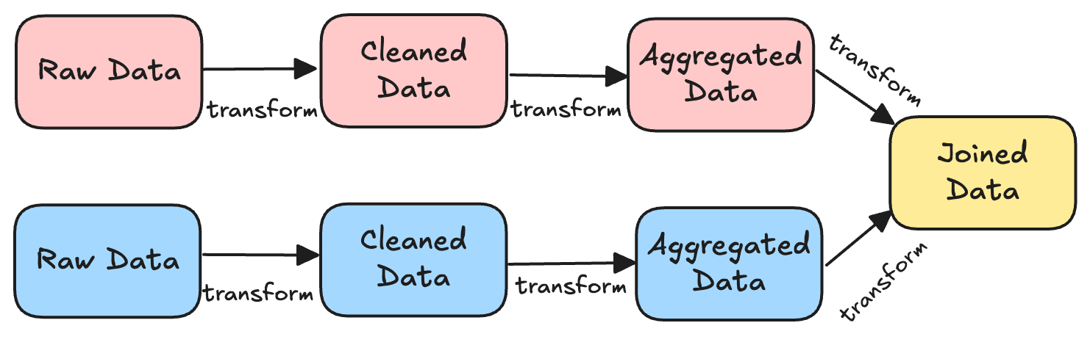
2.3 Modeling and Transformation: DAGs ("Data Lineage")
In all Data Engineering pipelines, data are manipulated via a series of steps, called "transformations"
Many transformations together are called a "Data Lineage" of Directed Acyclic Graph (DAG)
We are big fans of visualising DAGs in a User Interface. Soon you will learn how to do that with Dagster!
Example of a DAG:
Oliver

Slide 31
2.3 Modeling and Transformation: DAGs ("Data Lineage")
Example of a DAG:
Raw
Clean
Aggregated
Date (STR) | Food Item (STR) | nItems (STR)
2023-01-15 | Applle | 200
Feb 3, 2023 | Aubergine | 400.0
30.02.2023 | Eggplant | eighty
Feb 4, 2023 | Apple | five
Date (DATE) | Food Item (STR) | nItems (INT)
2023-01-15 | Apple | 200
2023-02-03 | Eggplant | 400
NULL | Eggplant | 80
2023-02-04 | Apple | 5
Food Item (STR) | Sum nItems (INT)
Apple | 205
Eggplant | 400
Flow of Data
Oliver

Slide 32
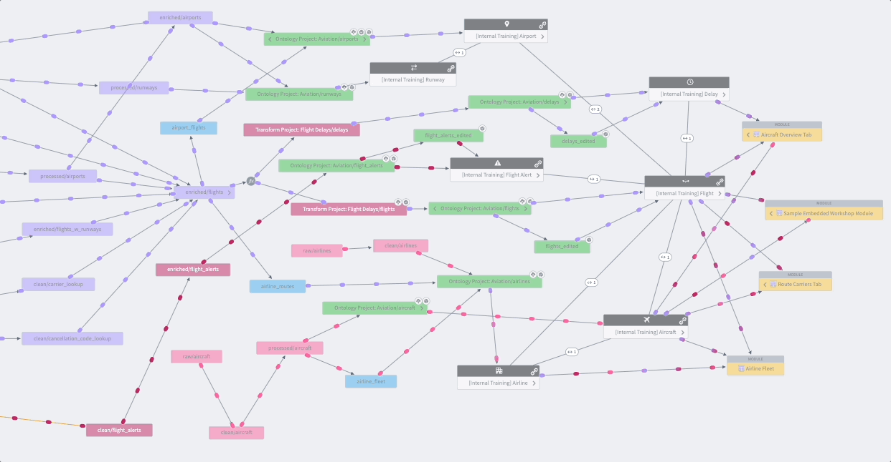
2.3 Modeling and Transformation: DAGs ("Data Lineage")
DAG visualisations are used in any modern Data Engineering software.
Palantir Foundry:
Oliver

Slide 33
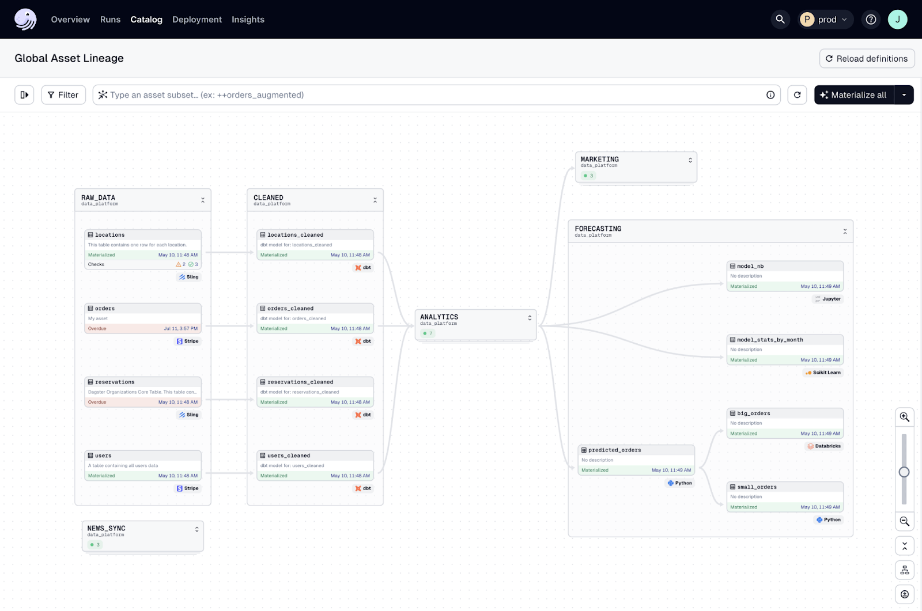
2.3 Modeling and Transformation: DAGs ("Data Lineage")
DAG visualisations are used in any modern Data Engineering software.
Dagster:
Oliver

Slide 34
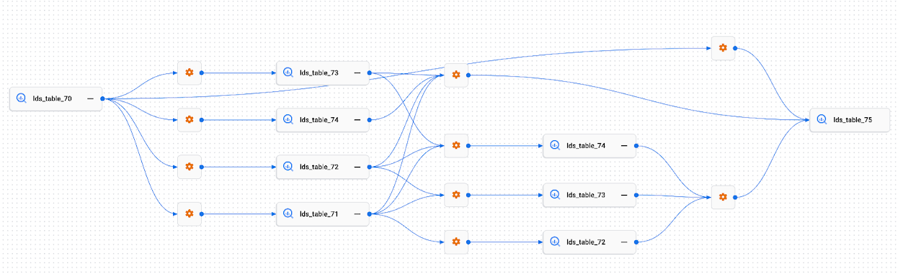
2.3 Modeling and Transformation: DAGs ("Data Lineage")
DAG visualisations are used in any modern Data Engineering software.
GCP Dataplex:
Oliver

Slide 35
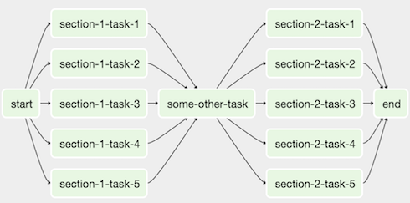
2.3 Modeling and Transformation: DAGs ("Data Lineage")
DAG visualisations are used in any modern Data Engineering software.
Apache Airflow:
Oliver

Slide 36
2.3 Modeling and Transformation: ETL vs ELT
Legend:
Performed in source DB:
Performed in Target Storage:
Extract Transform Load (ETL):
Extract
Transform
Load
ColA | ColB | ColC
2023-01-15 | Apple | 200
ColA | ColB
2023-01-15 | Apple
ColA | ColB
2023-01-15 | Apple
Extract Load Transform (ELT):
Extract
Load
Transform
ColA | ColB | ColC
2023-01-15 | Apple | 200
ColA | ColB | ColC
2023-01-15 | Apple | 200
ColA | ColB
2023-01-15 | Apple
Oliver

Slide 37
2.3 Modeling and Transformation: ETL vs ELT
 | ETL | ELT
Full Name | Extract Transform Load | Extract Load Transform
Primary Goal | Take only what you need; and process data before loading | Take full table, and process on target system
Availability | Minimal — only subset of columns are available on target storage | All (no need to answer question "which columns do I need?" beforehand):
Flexibility | Minimal (harder to make changes to initial transform logic) | Great
Scalability | Poor | Good (since all data re loaded, easy to use more columns/rows in downstream data pipeline)
Storage Requirement | Minimal (subset of data are loaded) | Large (all data are loaded)
Best for | Data Warehouse | Data Lakes / Lakehouses (cheap storage)
Oliver

